Slide 1
ORL 5524 Session 11.0-13.0 Item and Scale Evaluations Professor Madhabi Chatterji Teachers College, Columbia University

Slide 2
Agenda for Sessions 11-14
Empirical evaluations of item quality, validity, reliability, derived score scales and standard setting.
Statistics that apply, SPSS
Item analysis -Procedures for norm-referenced tests (NRTs) versus criterion-referenced tests (CRTs)
Item-analysis -Procedures for rating scale data
READINGS: Designing and Using Tools for Educational Assessment, Chatterji (2003), Chapters 11-14 and enrichment articles

Slide 3
Types of Empirical Evidence collected during the Design Process
VALIDITY
Item quality and functioning
RELIABILITY
Internal consistency reliability
1) Split –half reliability estimation with Spearman Brown correction
2) Kuder-Richardson reliability estimation (binary scored data)
3) Cronbach’s alpha reliability estimation (rating scale data)
Test-retest reliability
Inter-rater reliability

Slide 4
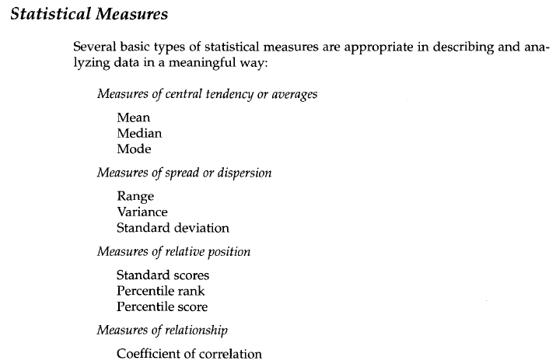

Slide 5
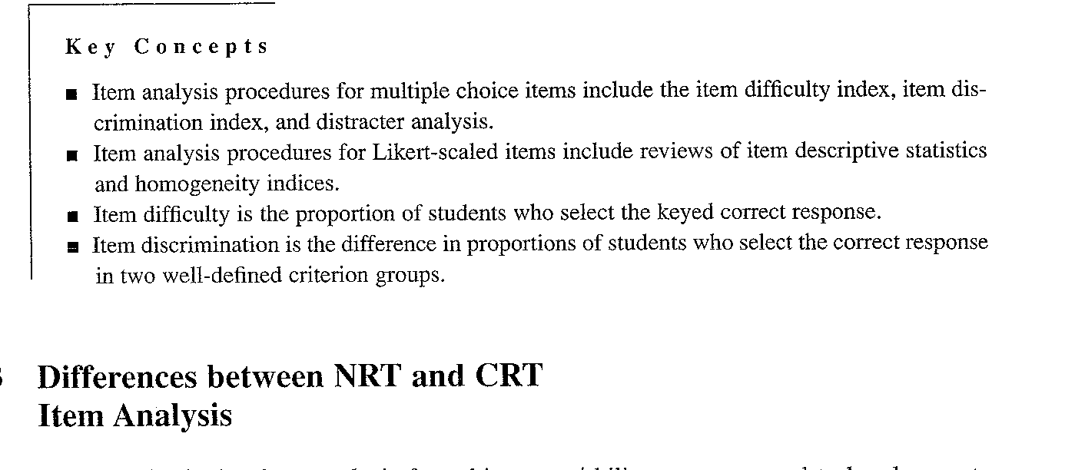
Psychometric Indices of Item Quality: Item Difficulty (p value)-NRTs and CRTs Item Discrimination (D value)- )-NRTs and CRTs Item Means, Variances and Homogeneity Indices (Item-total score correlations adjusted for item, squared multiple correlations adjusted for item)- Non-cognitive Scales

Slide 6
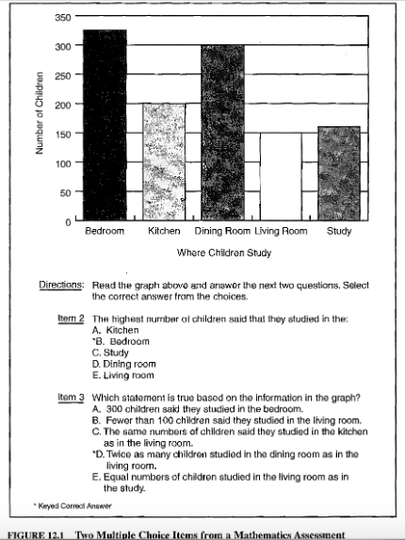
Examples of multiple choice items for elementary students

Slide 7
Designing a cognitive test- Person x Item Matrix from Items in a Multiple Choice Test (Binary Data indicating Correct/Incorrect Responses)
Raw score or Marginal score
 | I₁ | I₂ | I₃ | I₄ | … | I_{n}
P₁ | 0 | 1 | 1 | 1 |  |  | 3
P₂ | 1 | 0 | 0 | 1 |  |  | 1
P₃ | 0 | 0 | 0 | 0 |  |  | 0
P₄ | 1 | 1 | 0 | 0 |  |  | 2
:
:
P_{n}
Items
Persons
Marginal score
CTT: Observed score (X) is the Raw Score
X=True score (T) + Error (E)
IRT: Marginal raw scores are used to predict item responses
Scaling persons (subject-centered); scaling items & persons (response-centered)

Slide 8
“DIF” and Distracter analysis
NRT Item Analysis
CRT Item Analysis
Differential Item Functioning (DIF) analysis
Distracter analysis in MCQs

Slide 9
Definitions of Item p and D values in NRT Design
NRT Item p: Proportion of examinees who answer the item “correctly” ( as in NRTs)
NRT Item D: Differences in proportions of examinees who answer the item “correctly” in two clearly differentiated groups)
E.g.,
High ability on domain
Low ability on domain
(Goal of NRT is get maximum variance—to spread out the distribution of scores. Hence, item selection must mimic the normal or near-normal curve!)

Slide 10
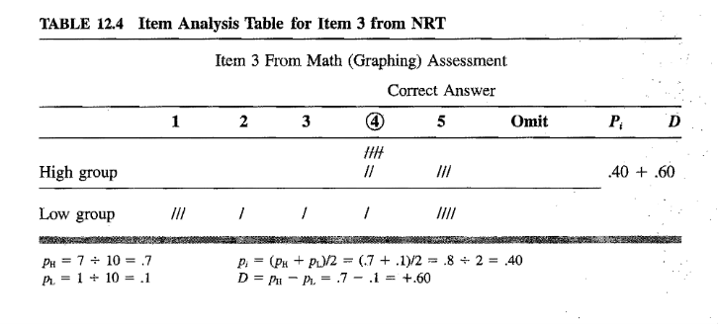
Item evaluations: NRTs

Slide 11
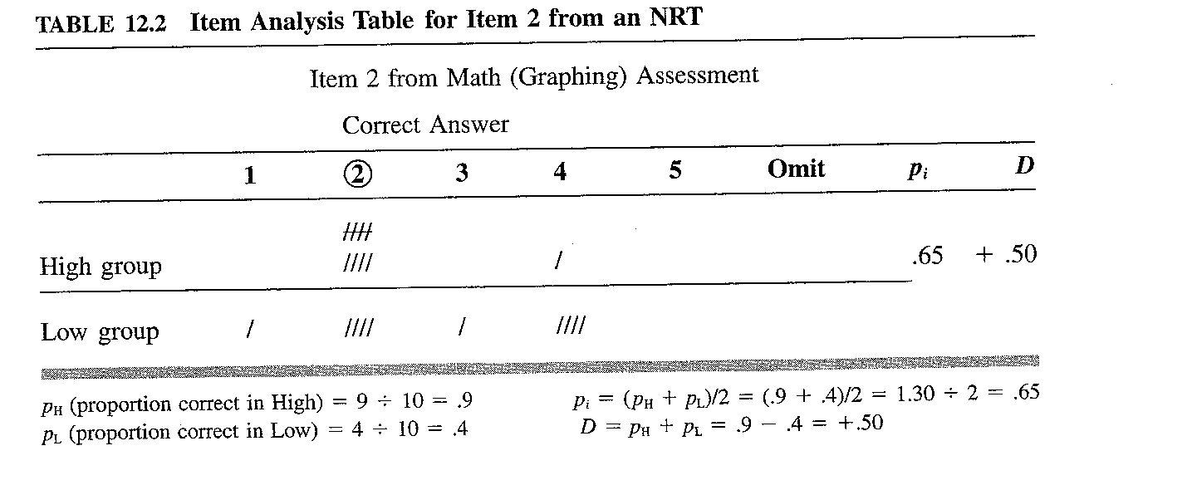
NRT Item Analysis: Demonstration

Slide 12
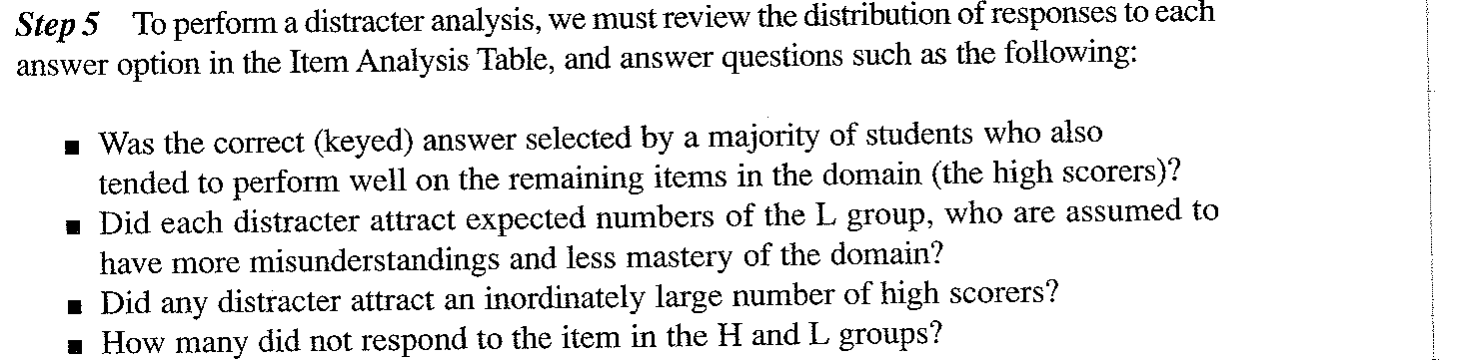
Distracter analysis of a multiple choice item

Slide 13
Definitions of Item p and D values in CRT Design
CRT Item p: Proportion of examinees who answer the item “correctly” ( as in NRTs)
CRT Item D: Differences in proportions of examinees who answer the item “correctly”
Goal of CRT: Instructional sensitivity of items in -DIFFERENT FROM NRTs
E.g.,
Pre vs Post instruction groups
Instructed (Expert) vs. Uninstructed (Novice)

Slide 14
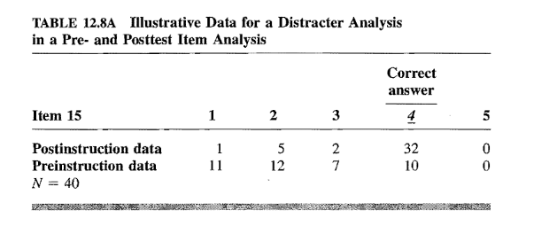
CRT Item evaluations and Distracter Analysis
Note: CRT item analysis requires different criterion groups!

Slide 15
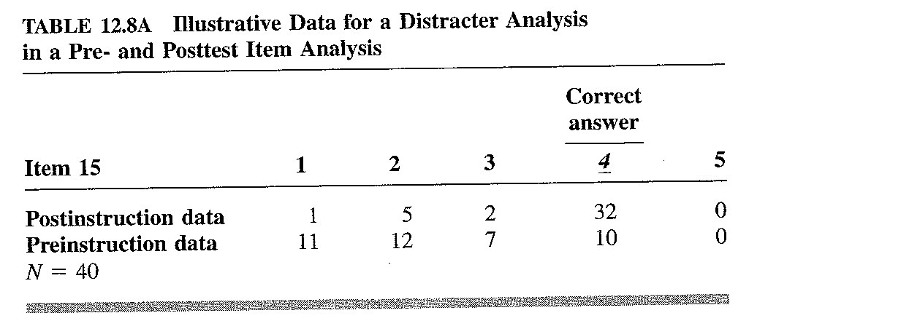
Item Analysis for a CRT Multiple Choice Item

Slide 16
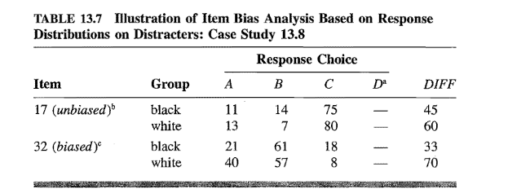
Item bias analysis: Differential Item Functioning (DIF) with chi-squared tests

Slide 17
Illustrative Item Analysis
Item # | Item Difficulty Statistics |  |  | Item Discrimination Statistics
 | Low Group (Beginner students) n=25 | High Group (Advanced students) n=25 | Total Group N=50 | Total Group N=50
1 | 0.26 | 0.64 | 0.45 | +.18
2 | 0.35 | 0.88 | 0.79 | +.53
3 | 0.91 | 0.92 | 0.92 | +.01
4 | 0.48 | 0.68 | 0.57 | +.20
5 | 0.43 | 0.68 | 0.57 | +.25
6 | 0.92 | 0.48 | 0.69 | -.44

Slide 18
Evaluating Item and Scale Properties on Non-Cognitive Scales ( E.G. Items from Self-efficacy scale)
Examine item-level distributions
Frequencies, response scale category usage, means, standard deviation, variance
Diagnose item functioning based on:
Adjusted Item-total score correlations
Squared multiple correlations
Cronbach’s alpha if item deleted
Revise/delete items, as needed
Compute “scale” scores by summing well functioning items; compare/examine distributional properties of scale scores with items added and deleted
[As applicable to your validation plan]

Slide 19
Person x Item Matrix (Rating Scale Data)
Raw score or Marginal score
 | I₁ | I₂ | I₃ | I₄ | … | I_{n}
P₁ | 2 | 2 | 5 | 4
P₂ | 1 | 4 | 3 | 3
P₃ | 2 | 3 | 3 | 3
P₄ | 1 | 5 | 3 | 4
:
:
P_{n}
Items
Persons
Marginal score
CTT: Observed score (X) = True score (T) + Error (E)
IRT: Marginal raw scores are used to predict item responses
Scaling persons (subject-centered)
Scaling items & persons (response-centered)

Slide 20
I. Frequency distributions on items
What can I use this for?
a) Proportion selecting correct responses (p value) .
b) Scale or item descriptive statistics and distributions.

Slide 21
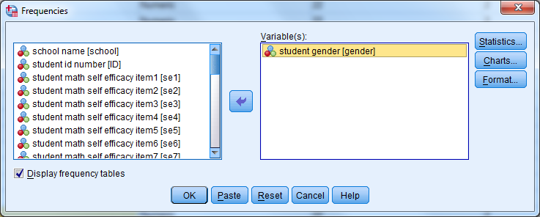
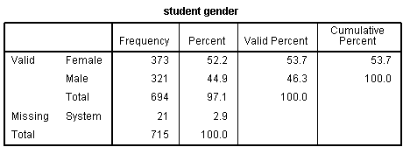
Click on OK in the frequencies dialog box. The SPSS Output Viewer will appear.
Sample Frequency Output of Student Gender
Notes:
Syntax for Frequency Analysis
FREQUENCIES VARIABLES=gender
/STATISTICS=STDDEV VARIANCE MEAN MEDIAN MODE
/ORDER=ANALYSIS.

Slide 22
II. Item Diagnostics and Scale Reliability for Non-cognitive Scales Purpose: To evaluate reliability of scale scores and contributions of items

Slide 23
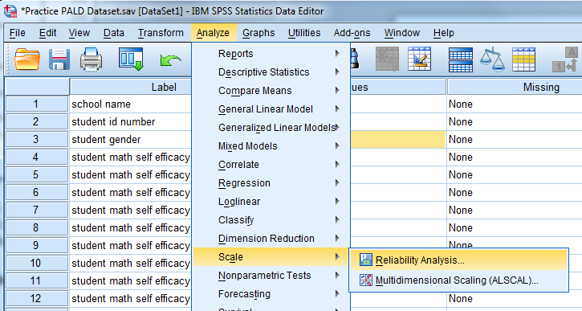
Analyze->Scale->Reliability Analysis

Slide 24
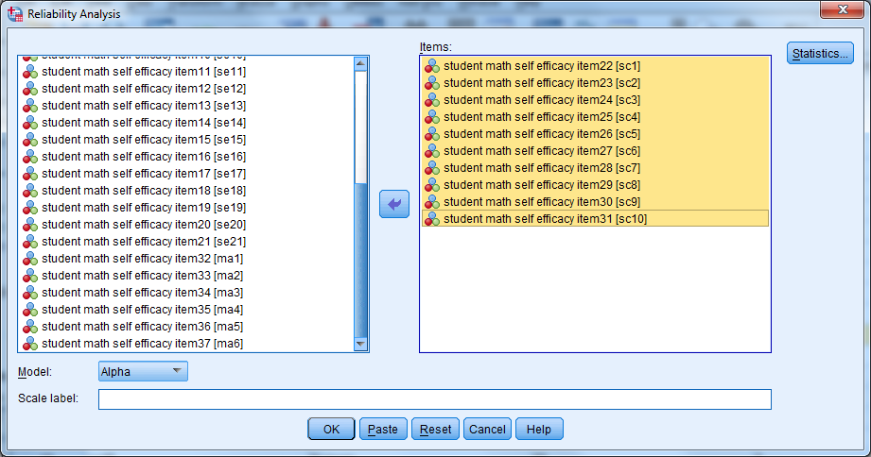
Transfer the variables “sc1" to “sc10" into the "Items:" box. Leave the "Model:" set as "Alpha", which represents Cronbach's alpha in SPSS. If you want to provide a name for the scale enter it in the "Scale label:" box. Since this only prints the name you enter at the top of the SPSS output, it is certainly not essential that you do; and in this case we will leave it blank. Click on the Statistics button, which will present the Reliability Analysis: Statistics dialogue box, as shown in the next slide.

Slide 25
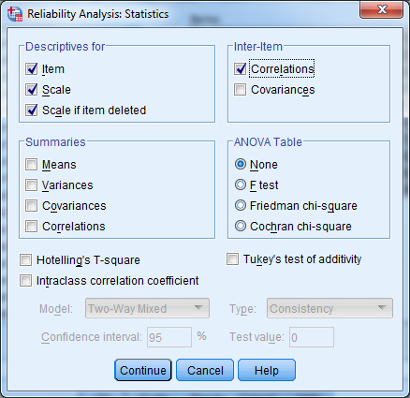
Select the "Item", "Scale" and "Scale if item deleted" in the "Descriptives for" box and "Correlations" in the "Inter-Item" box, as shown below. And click Continue button

Slide 26
Click on the OK button to generated output.
Notes:
Syntax for Reliability Analysis
RELIABILITY
/VARIABLES=sc1 sc2 sc3 sc4 sc5 sc6 sc7 sc8 sc9 sc10
/SCALE('Internal Consistency Reliability for Self-Concept Items') ALL
/MODEL=ALPHA
/STATISTICS=DESCRIPTIVE SCALE CORR
/SUMMARY=TOTAL.

Slide 27
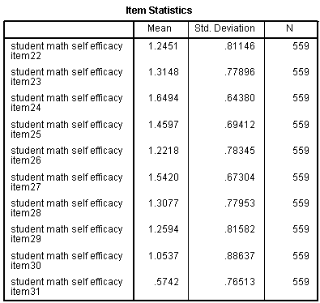
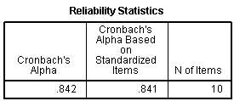
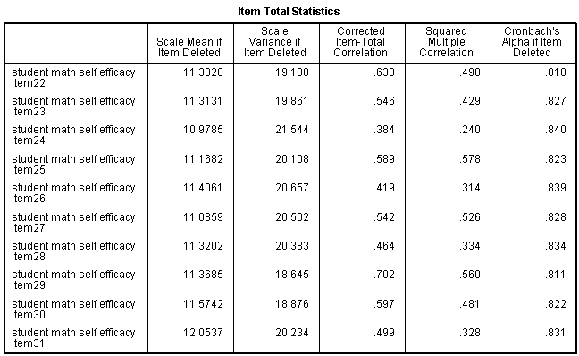
Sample Reliability Output of Math Self-Concept Items

Slide 28
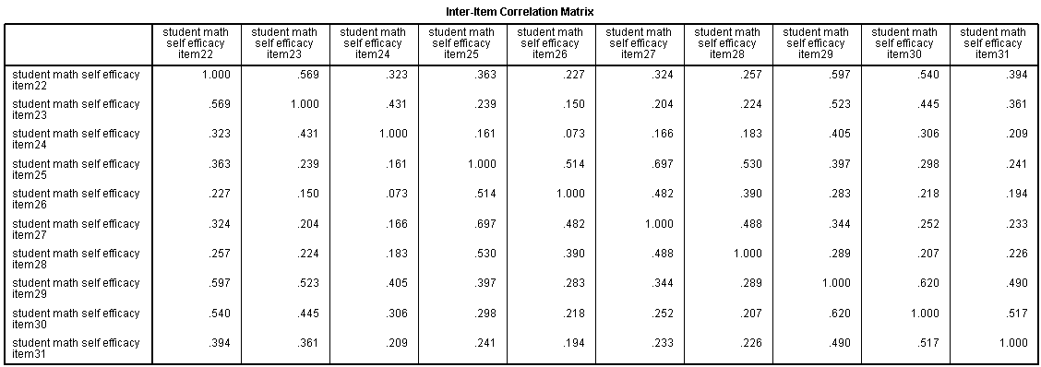
Inter-item correlation matrix: Sample Reliability Output of Math Self-Concept Items

Slide 29
V. Descriptive Statistics of Sub-scales and Scales When to perform: After scales and scores are validated and reliability os checked. Compared with the normal distribution

Slide 30
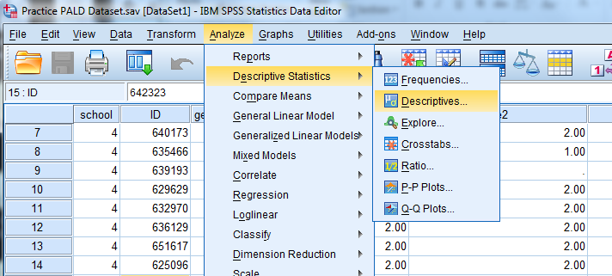
Analyze->Descriptive Statistics->Descriptives

